Slide 1

pfSense
The Handsome Seastars

Slide 2
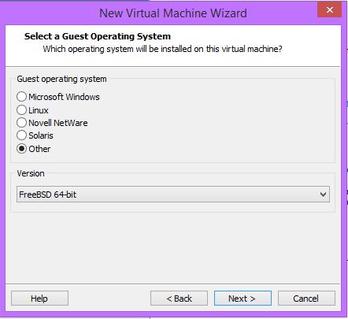
Installing pfSense
Once we got the ISO we installed it like any other, the only notable difference is OS selection
Select FreeBSD as the OS, this is what pfSense is built on

Slide 3
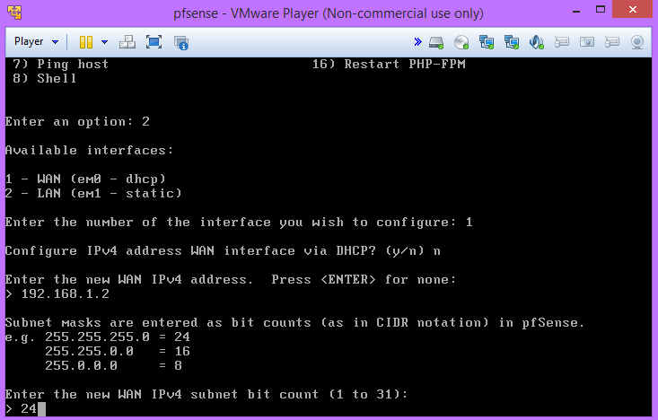
Setting Interface IP’s
First select option: 2
Then select the interface WAN or LAN you wish to configure
Here you can choose a static, or dynamic (DHCP) IP.
Opting out of DHCP allows you to assign a static IP

Slide 4
Restricting Web Interface to only LAN
It’s restricted by default

Slide 5
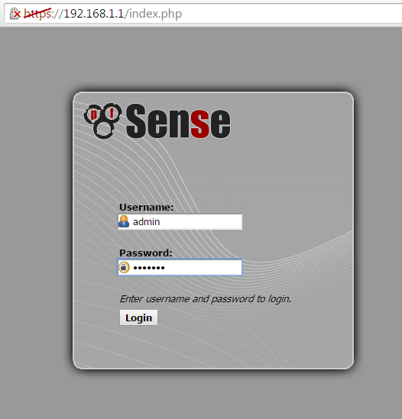
Log In

Slide 6
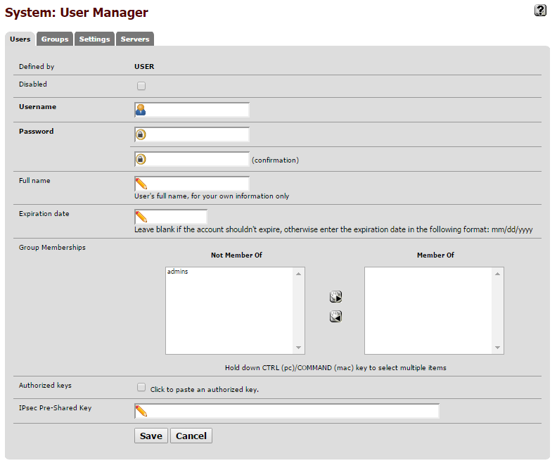
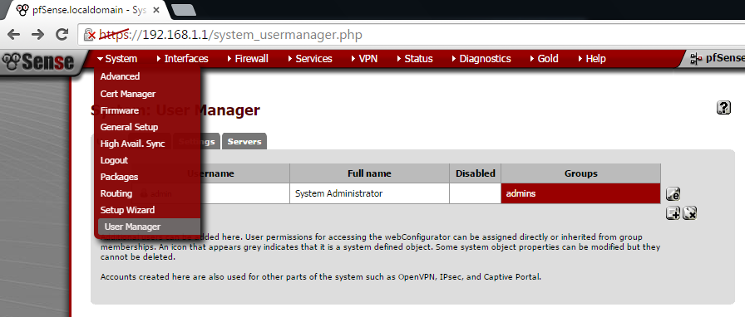
Add Users
System>User Manager>Users

Slide 7
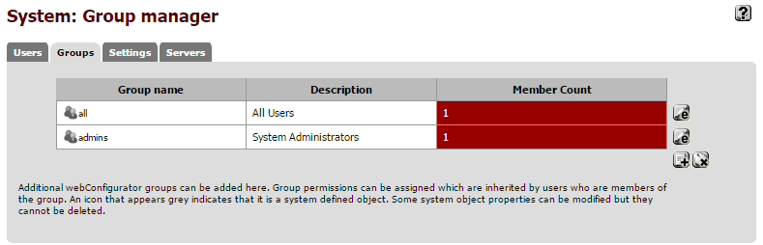
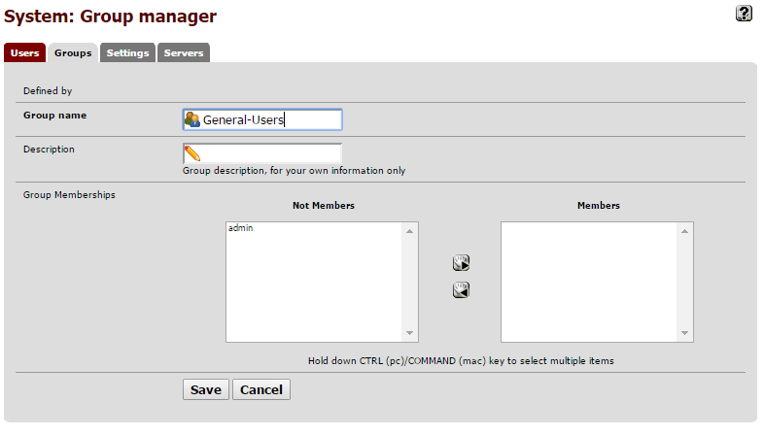
Groups
System>User Manager>Groups

Slide 8
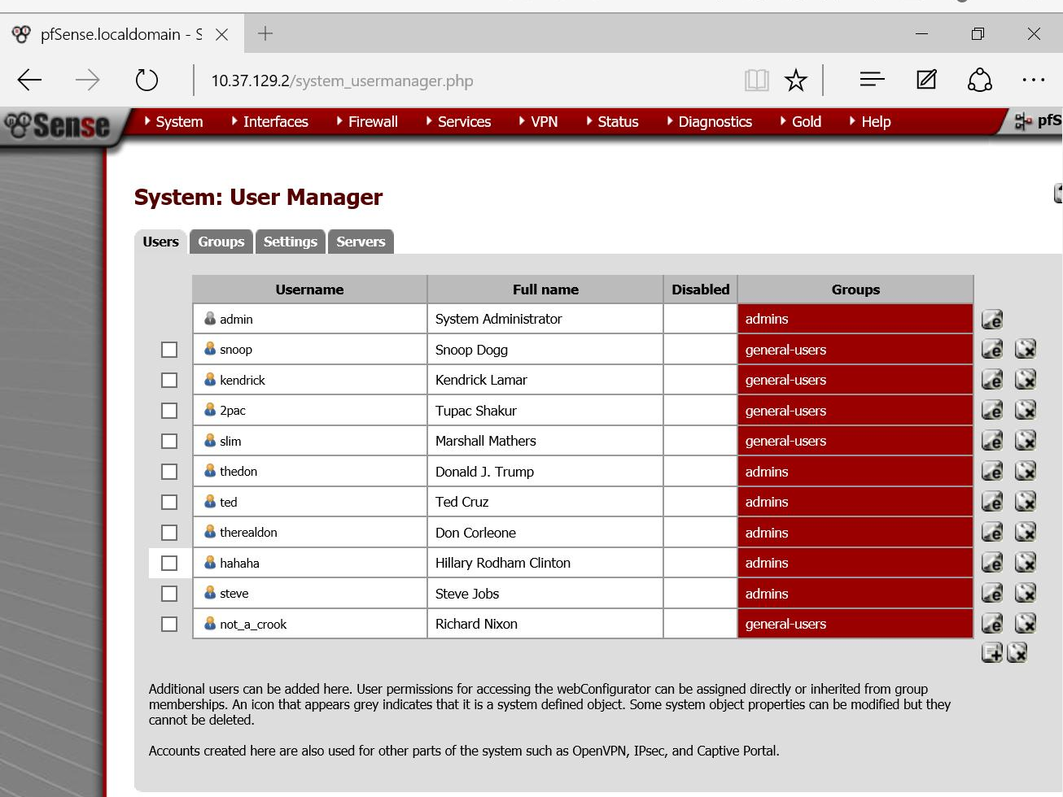
Users and Groups
System>
User Manager

Slide 9
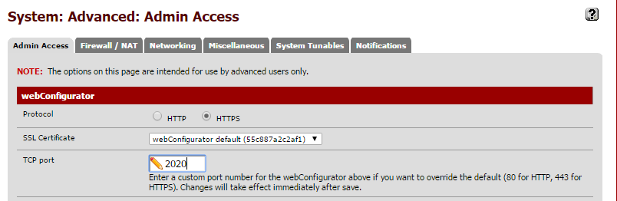
Access Port
Under System>Advanced

Slide 10
Disable webConfigurator login autocomplete
In the same place

Slide 11
Enable DNS Rebinding Checks
Disabled by default

Slide 12
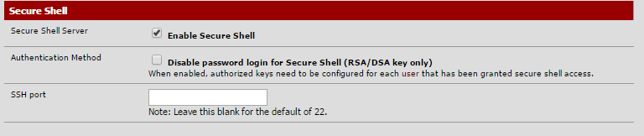
Enable SSH

Slide 13
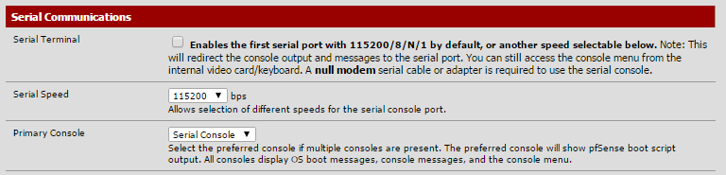
Find the Serial Speed of the Console Port

Slide 14
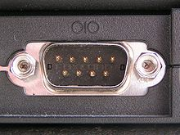
What’s a serial port?
A port where information is transferred sequentially, 1 bit at a time.
Used in modems, terminals, and printers
Actually includes USB and FireWire
Universal Serial Bus (RS232)

Slide 15
Disable hardware large receive offload
System>Advanced>Networking
Disabled by default

Slide 16
Disable hardware tcp segmentation offload
Disabled by default

Slide 17
Disable device polling
Disabled by default

Slide 18

Enable state killing on Gateway failure
System>Advanced>Misc.
Enabled by default

Slide 19

Clear invalid DF bits instead of dropping the packets
System>Advanced>Firewall/NAT

Slide 20
Set the firewall maximum state to 30000000
System>Advanced>Firewall/NAT

Slide 21
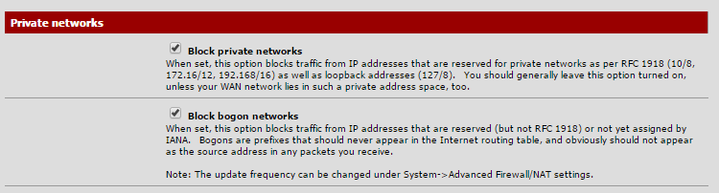
Block private and bogon networks on the WAN interface
System>Interfaces>WAN

Slide 22
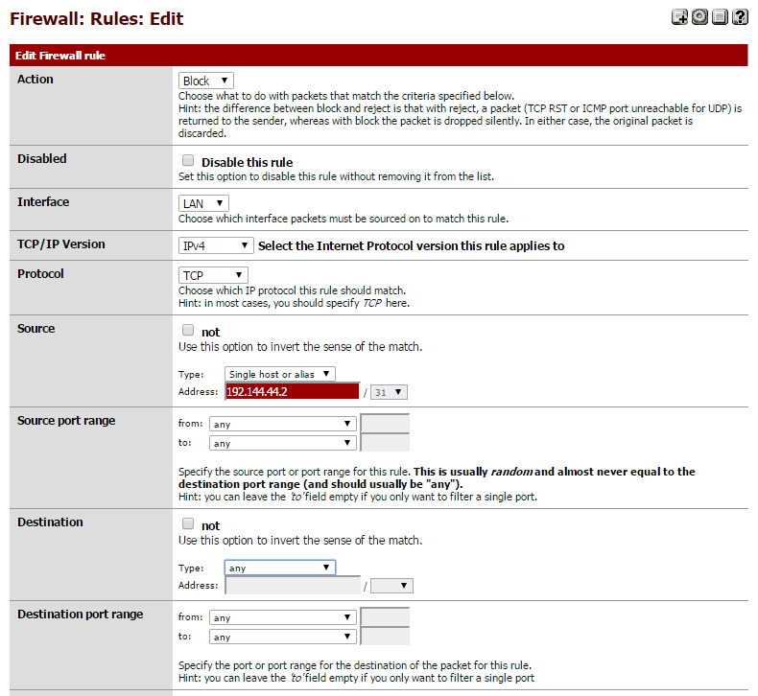
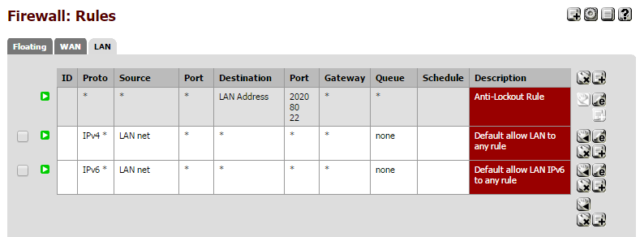
Deny 192.144.44.2 access to the internal network on all ports
Firewall>Rules>LAN click the add rule button

Slide 23
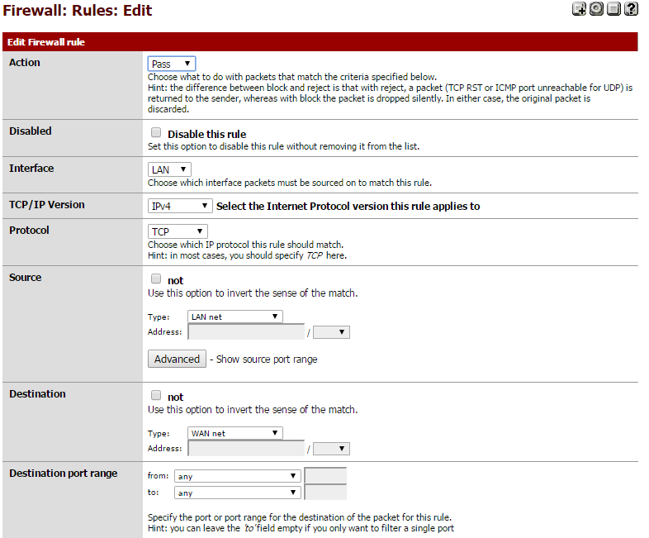
Any internal IP can access internet
Create another rule. This one any LAN can access any WAN on any port

Slide 24
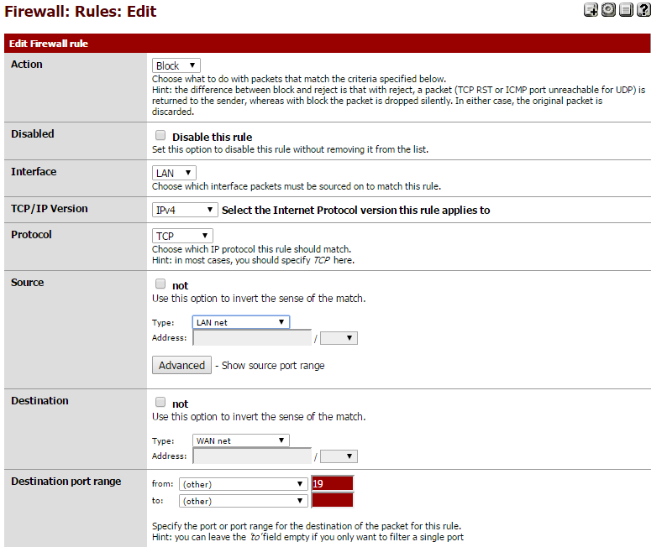
Disallow any traffic to go out from the internal network to the internet on port 19
Here we want the LAN net to be blocked from accessing the WAN net over port 19

Slide 25
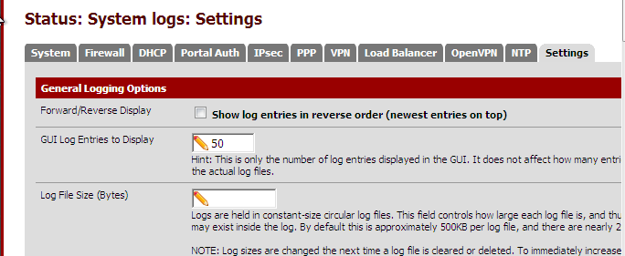
Turn on logging
Within Status -> System Logs: Settings you can check each event for logging

Slide 26
Enable logging on successful WebConfigurator logins
System>Advanced>Admin Access
Enabled by default

Slide 27
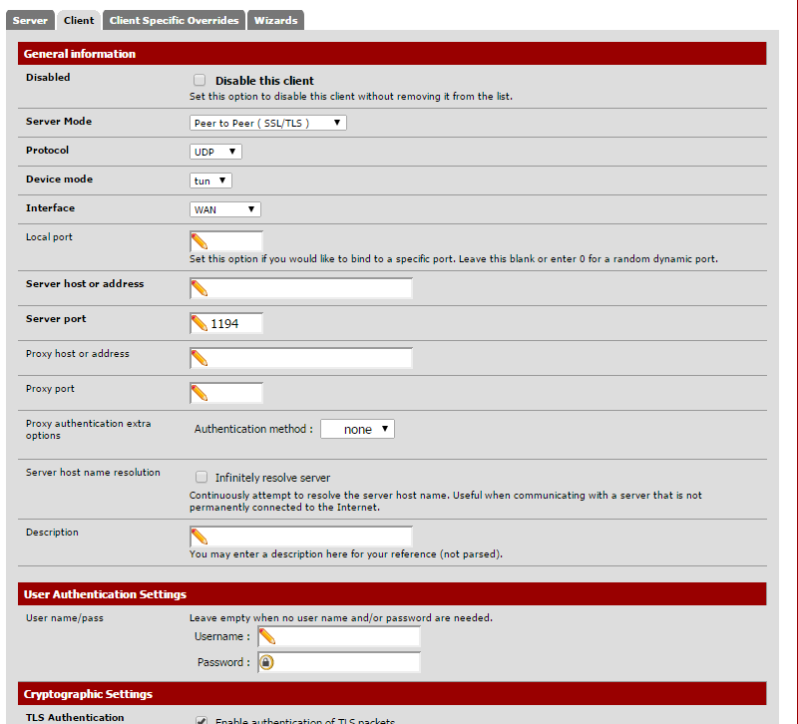
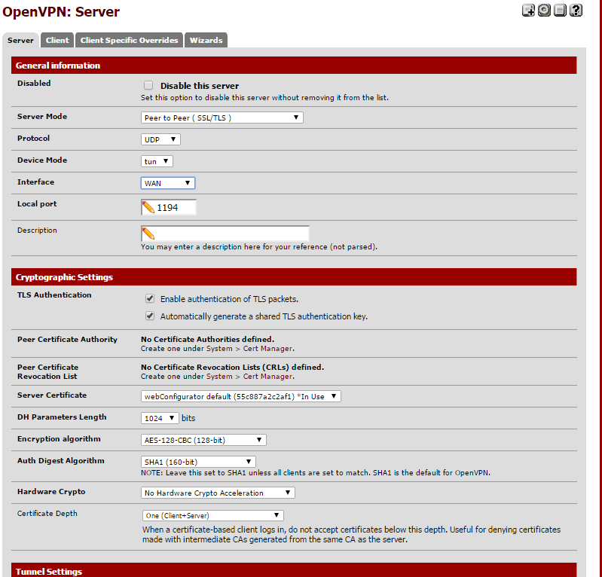
Configure openVPN for 5 users to have access through Firewall
Go to VPN>OpenVPN
First we need a server.Then we add our clients

Slide 28
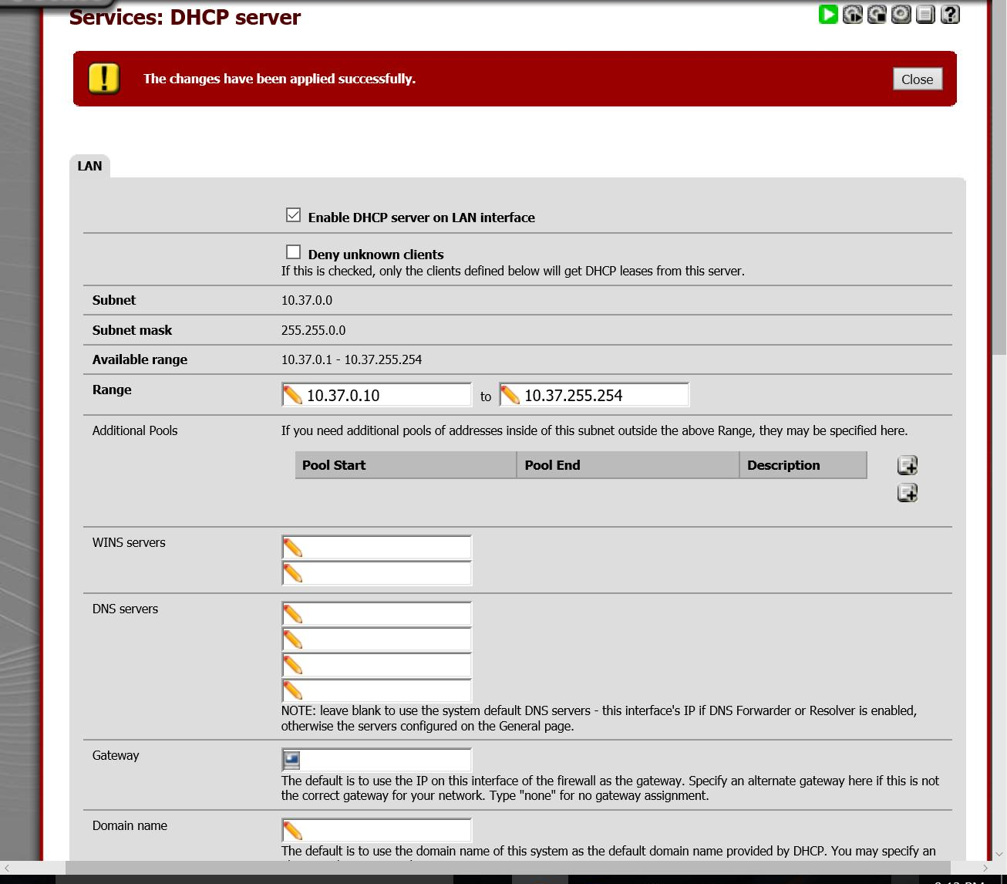
Configure DHCP Server

Slide 29
Configure RDP
RDP - Remote Desktop Protocol
RDP is used to wirelessly connect two computer to one another

Slide 30
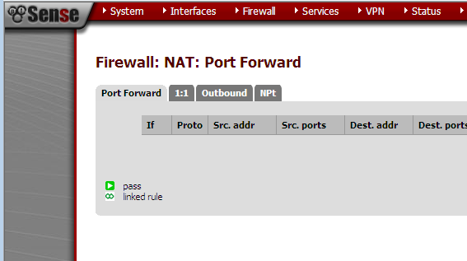
Configure NAT
NAT - Network Address Translation
NAT is mostly used for port forwarding
Port forwarding is often used hosting servers, BitTorrent, RDP, and SSH
NAT is used to translate desired IP packet headers
These rules are configurable in Firewall: NAT

Slide 31
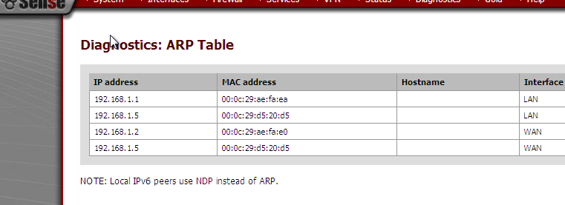
Find ARP Table note contents
The ARP Table is found under Diagnostics: ARP Table

Slide 32
Denying Inbound Connections
Use pfBlocker. Package for pfSense that replaces the older Country Block
System > Packages > Available > “+”
General
Set interfaces to be monitored
Inbound, outbound, both
Lists
Create or import list of IPs to block
Top spammers, countries, regions

Slide 33
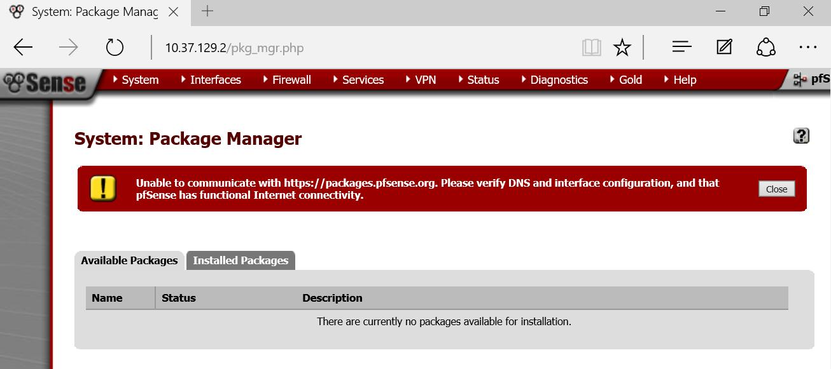
Denying Inbound Connections

Slide 34
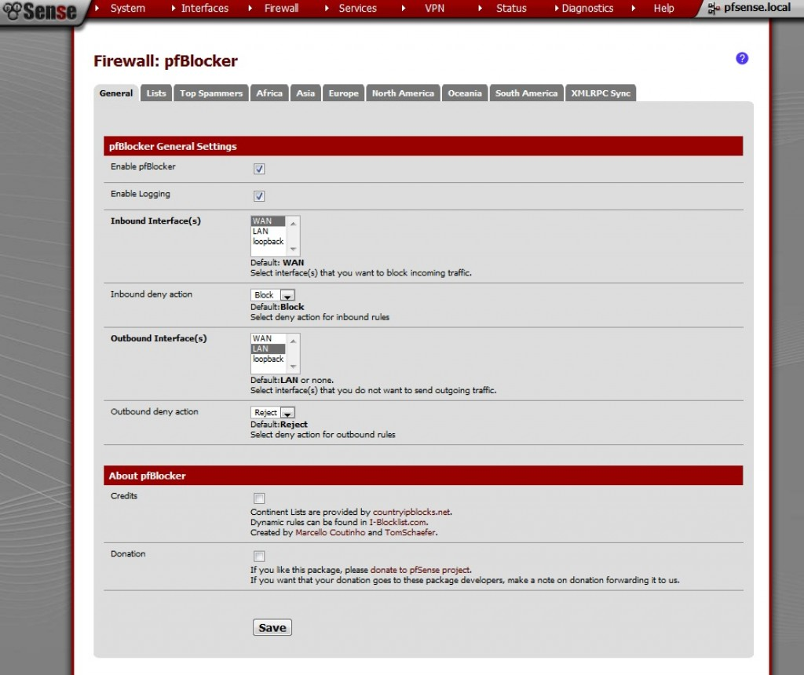

Slide 35
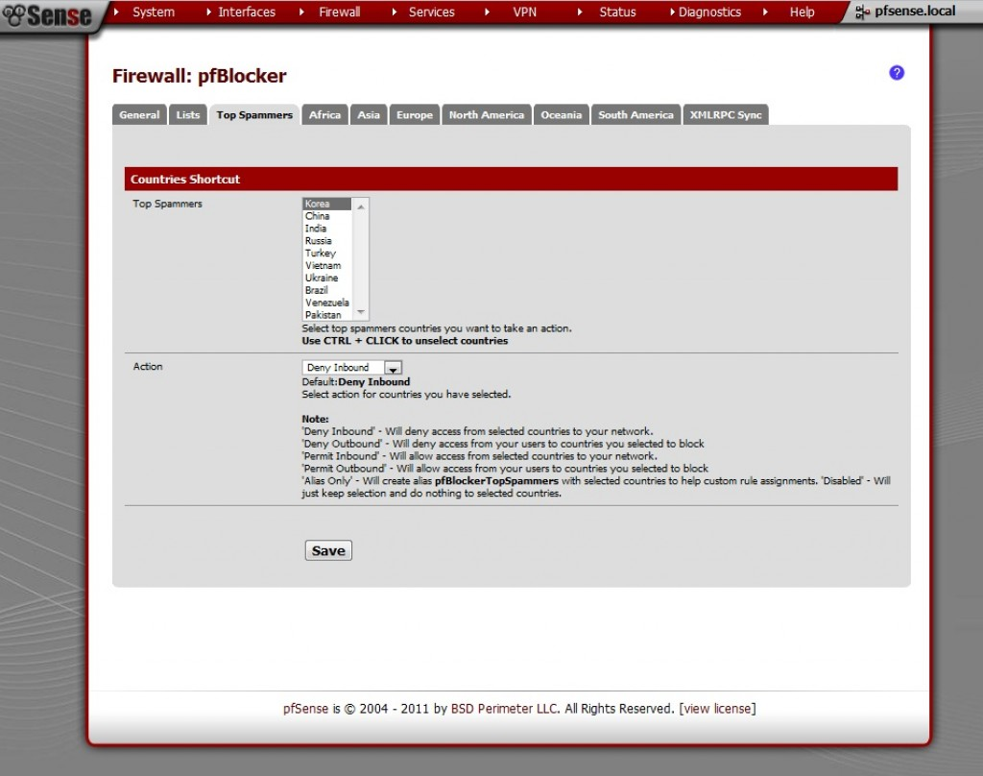

Slide 36
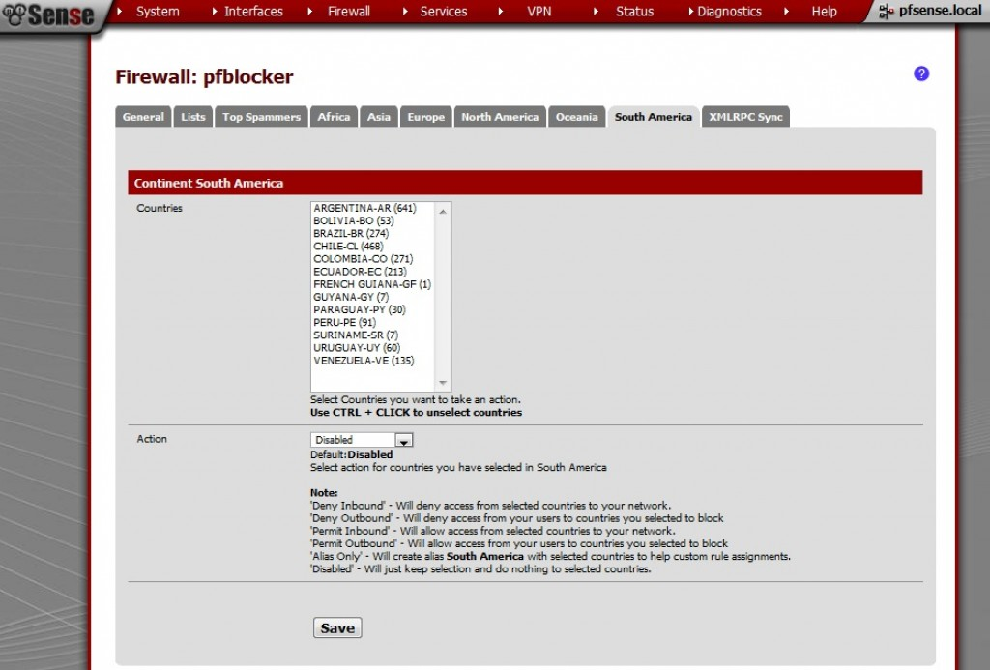

Slide 37
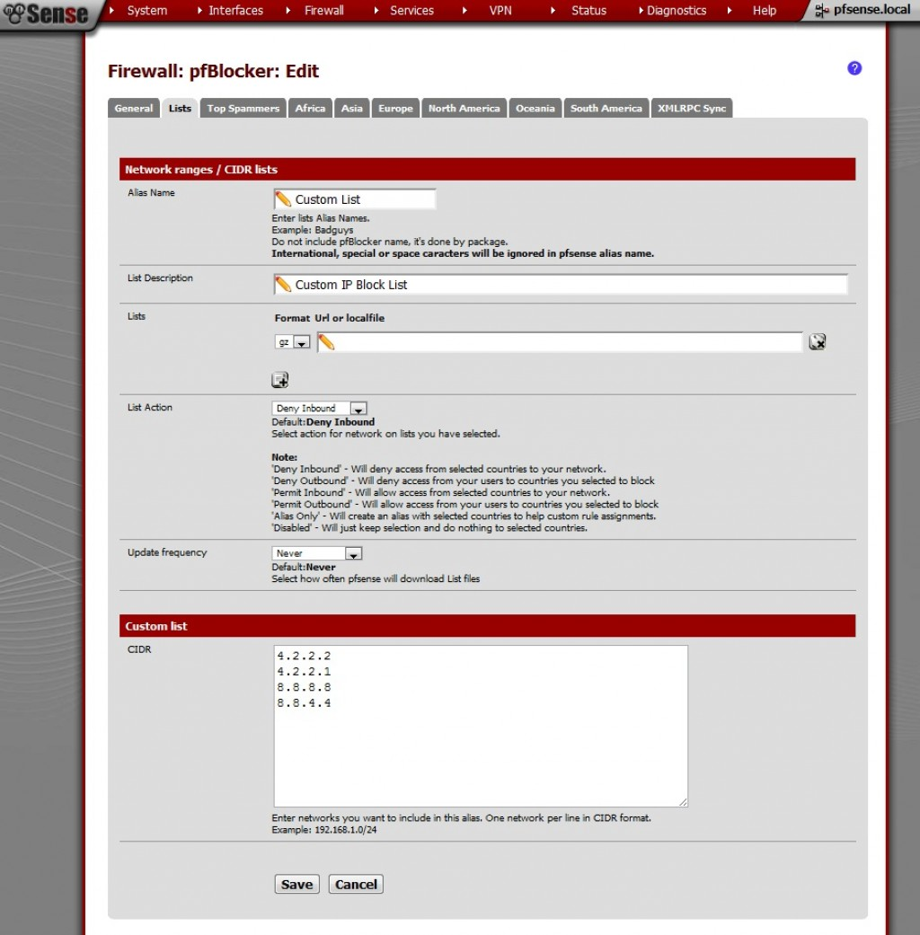
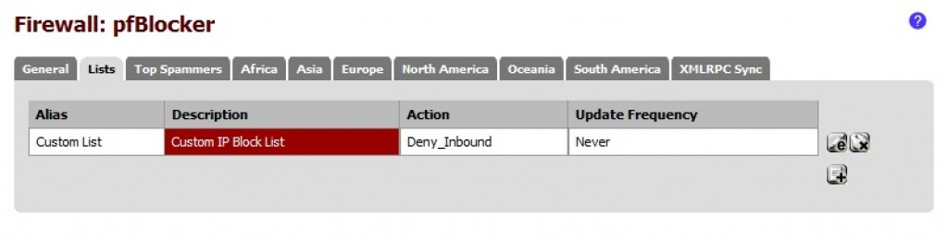

Slide 38
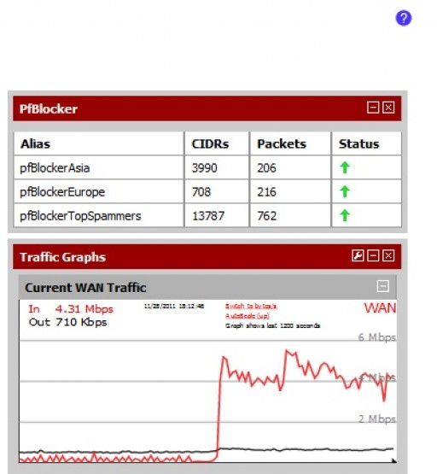

Slide 39

Enable static ARP on WAN side
When enabling a new DHCP Server this box allows for Static ARP Entries on the WAN side

Slide 40

Set the lease time to 100000 seconds on LAN side
Default lease time can be set on the DHCP server as well

Slide 41
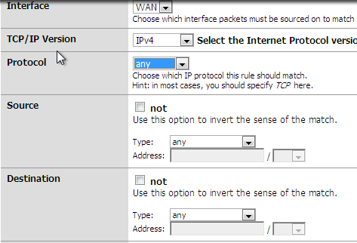
Make last WAN side rule deny all connections
By creating a new rule with no restrictions on the Block you can denny all WAN side connections

Slide 42
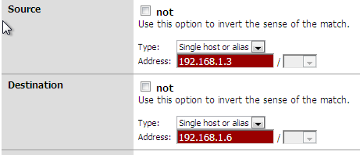
Deny a Windows Machine access to an Ubuntu machine
To block connection between an Ubuntu and Windows machine, simply create a floating rule in the firewall that blocks any connection from the Windows hot to the Ubuntu destination

Slide 43
Create VPN for Admin Accounts
3 options
L2TP ←
PPTP
Not recommended; insecure
OpenVPN
Must authenticate with Local User Access, LDAP (AD), or RADIUS

Slide 44
Create VPN for Admins w/ L2TP
3 options
L2TP ←
PPTP
Not used; insecure
OpenVPN
Must authenticate with Local User Access, LDAP (AD), or RADIUS

Slide 45
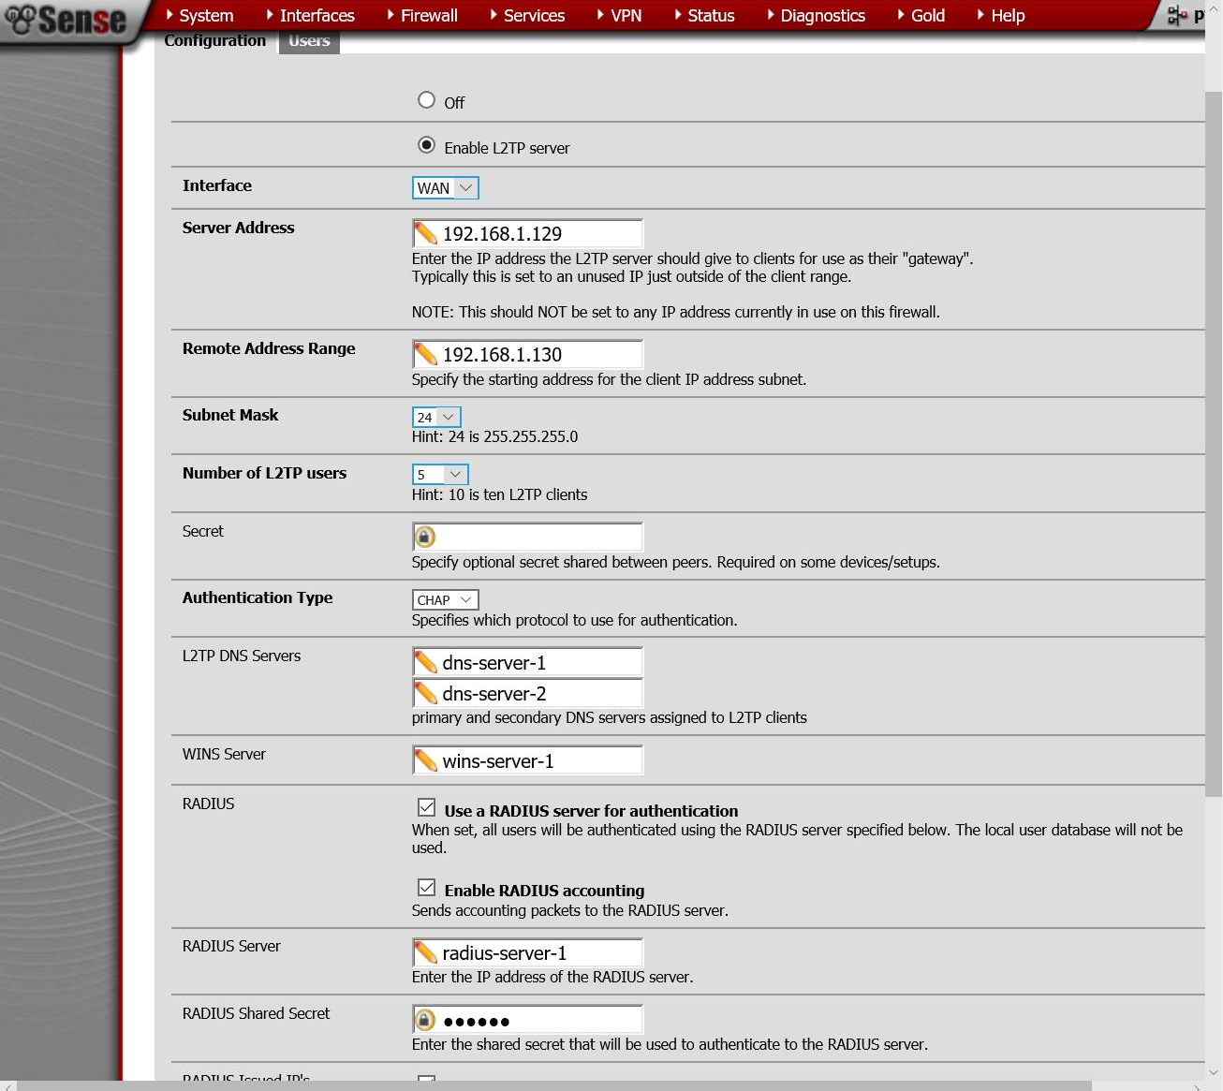
L2TP

Slide 46
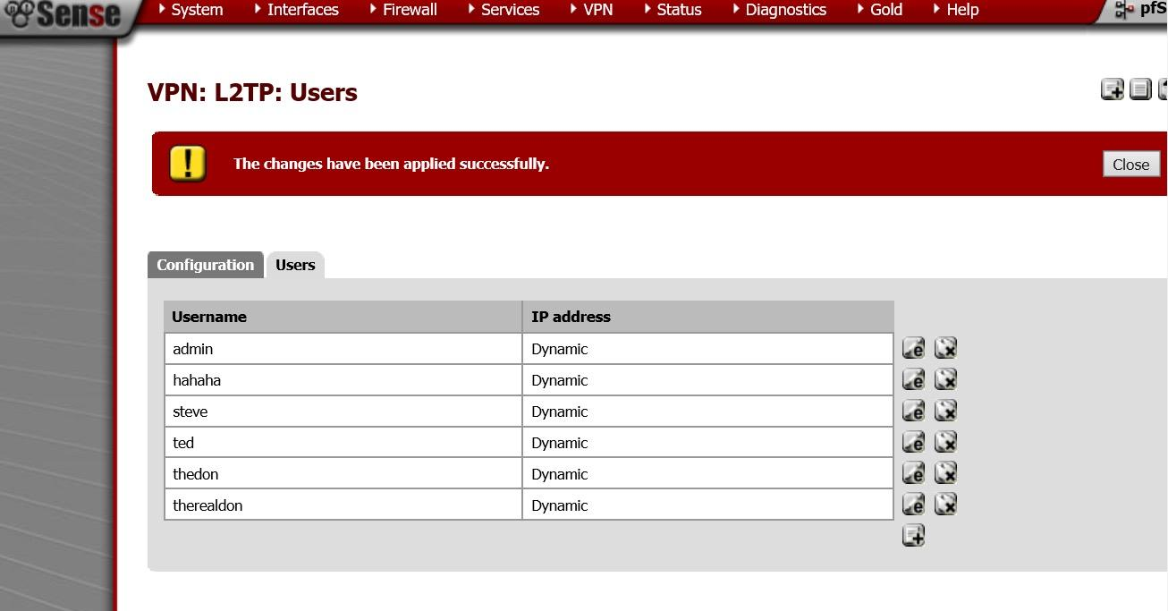
Users

Slide 47
L2TP vs PPTP vs OpenVPN: PPTP
RFC 2637: MS, Alcatel-Lucent, etc.
TCP control channel
GRE (gen. routing encap.) tunnel
PPP (point-2-point protocol) packets
Advantages
In Windows since 95
Very common
Multi-platform -- iOS, OS X, Android, BSD..

Slide 48
L2TP vs PPTP vs OpenVPN: PPTP
Disadvantages
Very old
Multiple attack vectors
CHAPv1 and 2 can be easily brute-forced
Online in less than 24 hours
Only standards supported by Windows
NSA scares
MPPE (Microsoft P2P Encryption) uses RC4 which leaves data vulnerable in transit
Bit-flipping
EAP-TLS is secure, but not really viable
Carry only PPP packets

Slide 49
L2TP vs PPTP vs OpenVPN: L2TP
Layer 2 Tunnel Protocol
Widely used VPN standard
No encryption/authentication by default!
But can supplement w/ IPsec → slower than PPTP
Orig. from Cisco’s L2F, PPTP
Better security
Better encapsulation
Carry other types of packets, not just PPP
Control -- has reliability
Data -- no reliability
Manageable through WFAS → Group Policy
Can get stuck behind firewalls

Slide 50
L2TP + IPsec
L2TP + IPsec
L2TP provides tunnel, IPsec secure channel
RFC 3193
Negotiation of IPsec Security Association through Internet Key Exchange
UDP 500, 1701
Private Shared Key, public key, X.509 certs…
Encapsulating Security Payload
Alternatives: OpenVPN (really good), SSTP for Windows (supports AES → fast, reliable)

Slide 51
L2TP vs PPTP vs OpenVPN: OpenVPN
Newer
Extensible
Plug-in support
Cross-platform, even on routers
Open-source
Custom security protocol
SSLv3/TLSv1 for key exchange
Not IPsec-compatible
NAT + firewall-safe
Multiple authentication schemes
PSK
Public key
Password-based
TCP + UDP

Slide 52

Create NAT rules for Ubuntu Machines
Creating a new NAT Rule under Firewall - NAT and dennying connection from IPs that are on the Ubuntu range, can stop all connections from Ubuntu Machines. Or for if you select destination instead of source

